Slide 1
CPU Architecture

Slide 2
CPU is made up of?
1.) The register set stored intermediate data used during the execution of instructions.
2.) The ALU performs the required microoperations for executing inst.
3.) The Control unit supervises the transfer of information among the register & instructs the ALU as to which operation to perform.
Register Set
Control
ALU

Slide 3
Stack Organization

Slide 4
Register Stack
C
B
A
63
FULL
EMPTY
3
SP
2
1
0
Block Diagram of a 64-word register stack
DR

Slide 5
Memory Stack
Memory Unit
Program
(Instructions)
Data
(Operands)
Stack
1000
PC
2000
AR
3000
3997
SP
3998
3999
4000
4001
DR

Slide 6
Register Organization

Slide 7
CLOCK
INPUT
R1
R2
R3
R4
R5
R6
R7
Load
7 Lines
MUX 8x1
MUX 8x1
SELA
SELB
3 x 8
Decoder
A BUS
B BUS
ALU
OPR
SELD
Output

Slide 8
Instruction Set Formats

Slide 9
Instruction Set Formats
1.) Fixed- length Instruction
Used in most RISC.
Instructions are 4 bytes long. For e.g. 32 or 64 bits
Allow for easy fetch & decode.
Simply pipelining and parallelism.
Operation, address field 1, address field 2, address field 3.
MIPS, SPARC, Power PC.

Slide 10
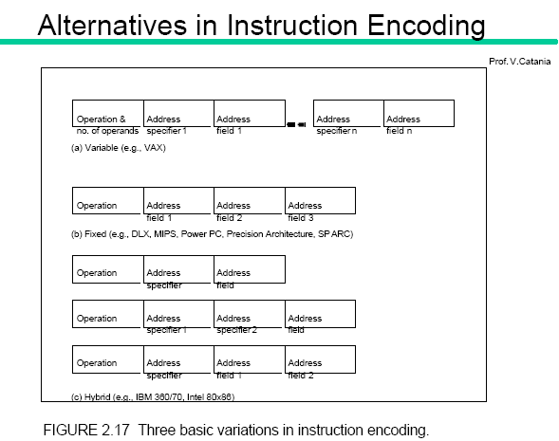
Fixed length instructions

Slide 11
Instruction Set Formats
2.) Variable Length Instructions
More Compact, harder to pipeline
Operation & # of operands, address specifier1, …, specifier n.
VAX, Intel 8086

Slide 12
Instruction Set Formats
3.) Hybrid length instructions
A mix of variable & fixed length instructions.
  Operation, address specifier, address field.
  Operation, address specifier 1, address specifier 2, address field.
  Operation, address field, address specifier 1, address specifier 2.

Slide 13
Hybrid

Slide 14
Summary
  If code size is most important, use variable format.
  If performance is most important, use fixed format.
  As for embedded applications, several RISC processors offer hybrid encoding method with both 16-bit and 32-bit instructions → reduce code size (e.g. ARM Thumb, MIPS16)

